Slide 1

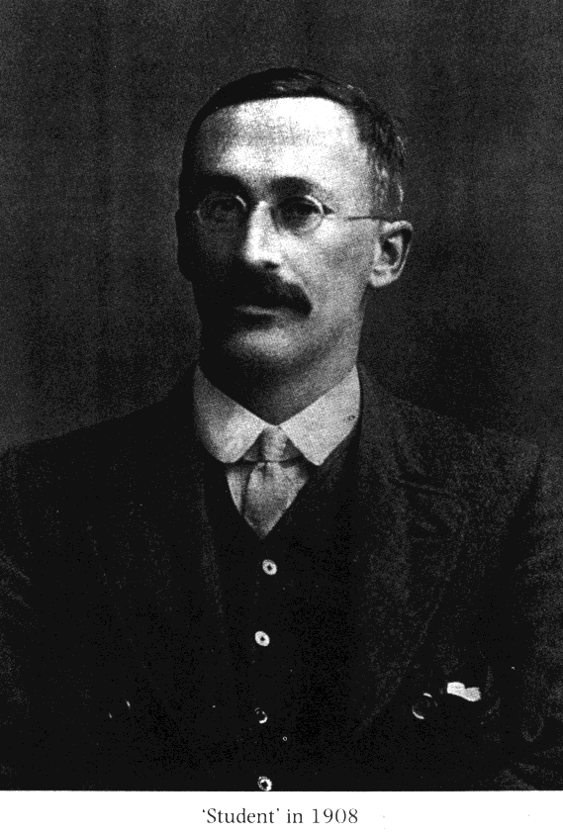

二日酔い!
How shall I deal with these small batches of brew?
GOSSET, William Sealy 1876-1937

Slide 2
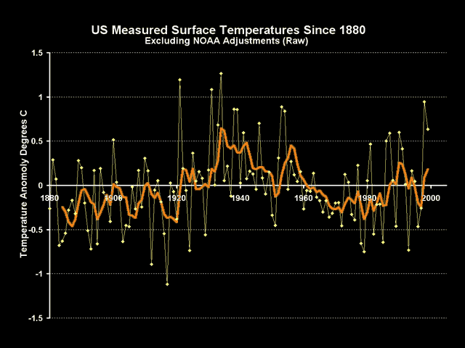
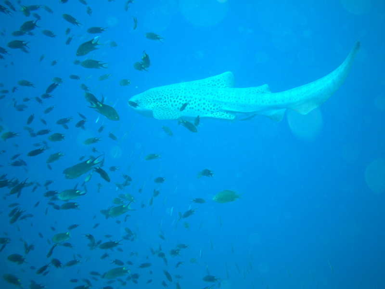
Monday, November 7
Independent samples t-test
for the difference between two means.
signal-to-noise ratio
safety in numbers

Slide 3
Topics
Magnitude of effect v. significance.
Point-biserial correlation.
Confidence interval for the difference between means.
Correlated samples t-test, design considerations.

